Slide 1


Bone fracture detection
FUSE AI FELLOWSHIP 2023-2024

Slide 2

1. TEAM MEMBERS
Joaquin Ayzanoa (Perú)

Slide 3
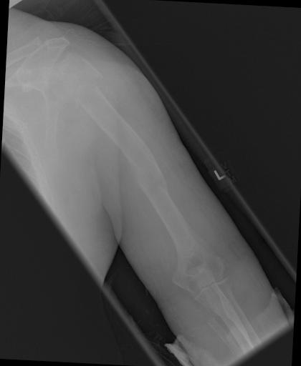
2. PROBLEM STATEMENT
A data set of bone fractures with which we want to train a machine learning model, specifically focusing on algorithms to automatically detect and classify bone fractures in X-ray images for better and fast registration for doctors and patients.

Slide 4
3. OBJETIVES
Detect and classify bone fractures in X-ray images for better and fast registration for doctors and patients.
Deploy the ML model with an interface so it can predict the type of fracture when someone upload an image.

Slide 5

4. GITHUB REPOSITORY LINK
This is the link of the repository:
https://github.com/JoaquinAyzanoa/PortafolioJA/tree/e96351fa14b03b0788fd2a7d78b996a5b3a9c38d/Fracture%20Bone%20Detection

Slide 6
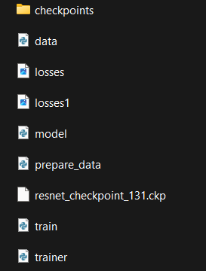
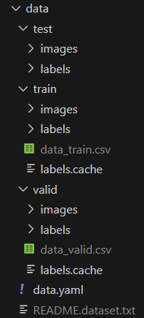
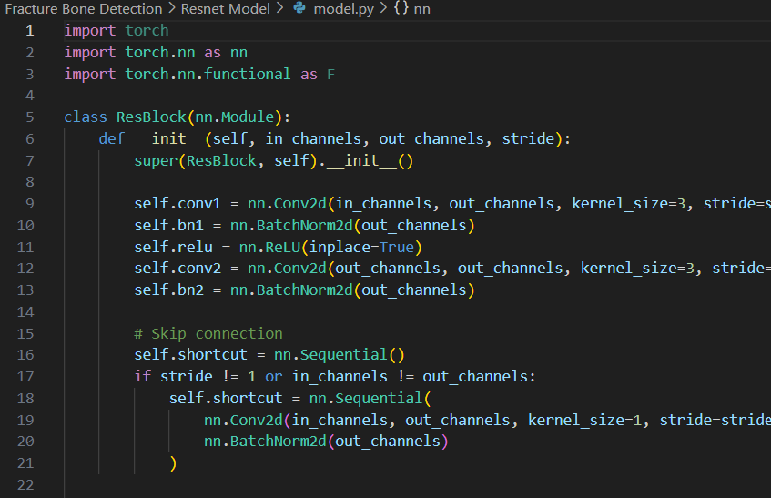
5. RESNET MODEL
The Resnet model was created from scratch using pytorch, no pretrained model or downloaded model was used here.

Slide 7
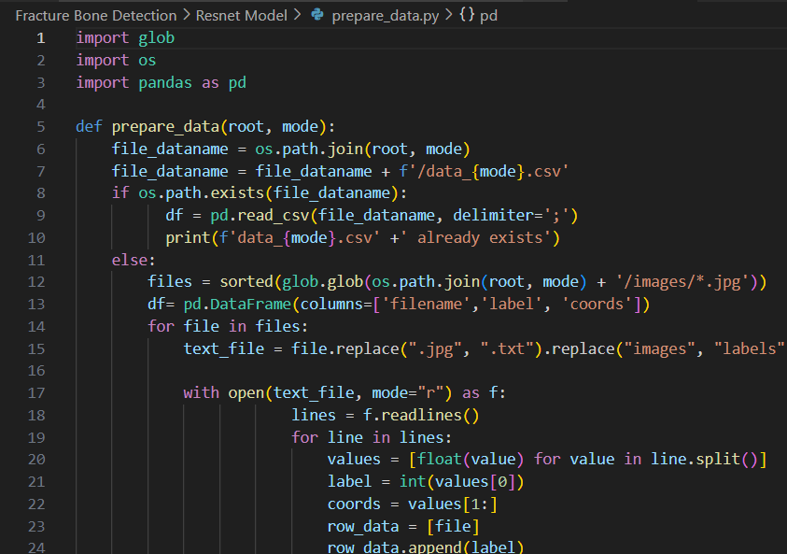
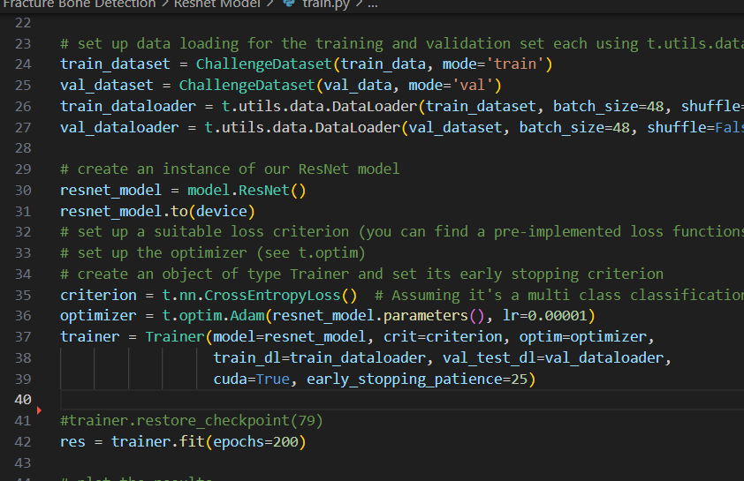
5. RESNET MODEL
The Resnet model was created from scratch using pytorch, no pretrained model or downloaded model was used here.

Slide 8
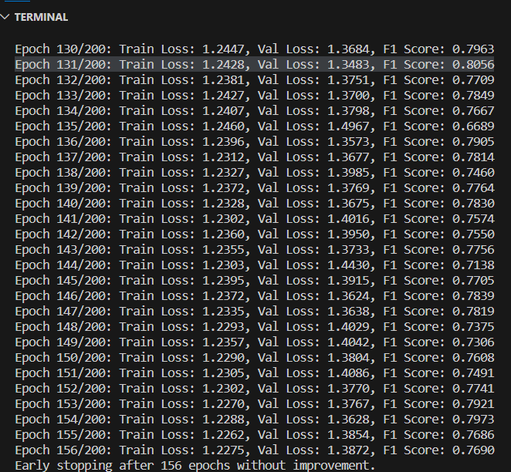
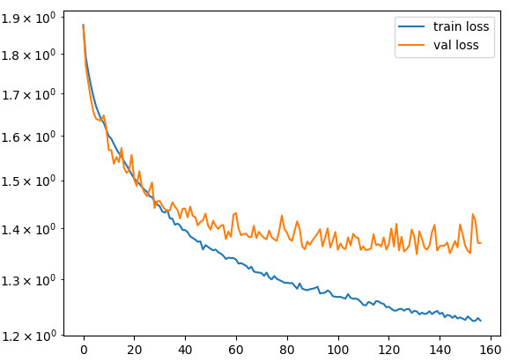
5.1 Results

Slide 9
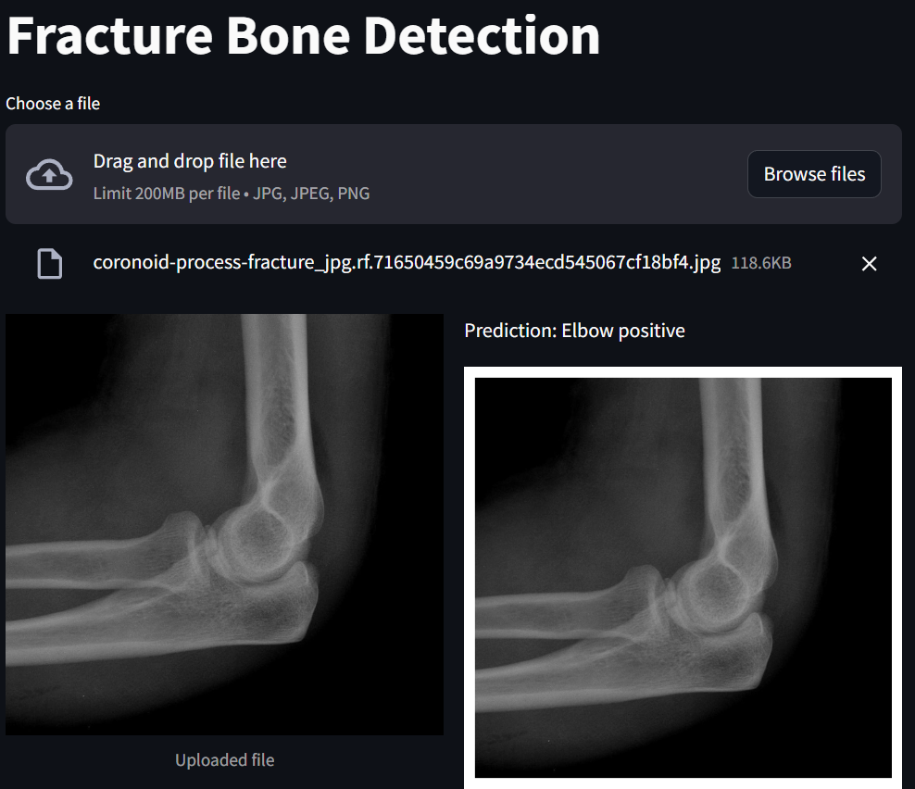
5.1 Results

Slide 10
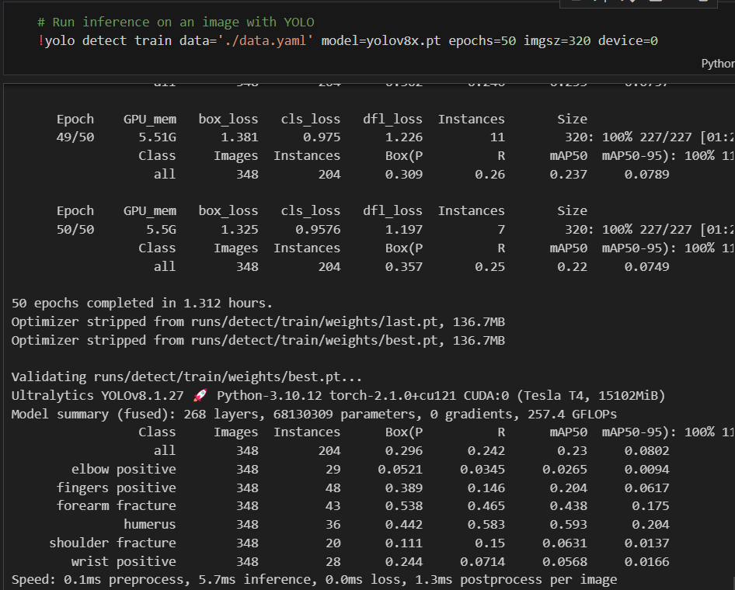
6. YOLO-V8 FOR OBJECT DETECTION
ultralytics
The YoloV8 model is a pretrained model downloaded from the library “Ultralytics”.
The YoloV8 was finetuned to bone fracture detection task.

Slide 11
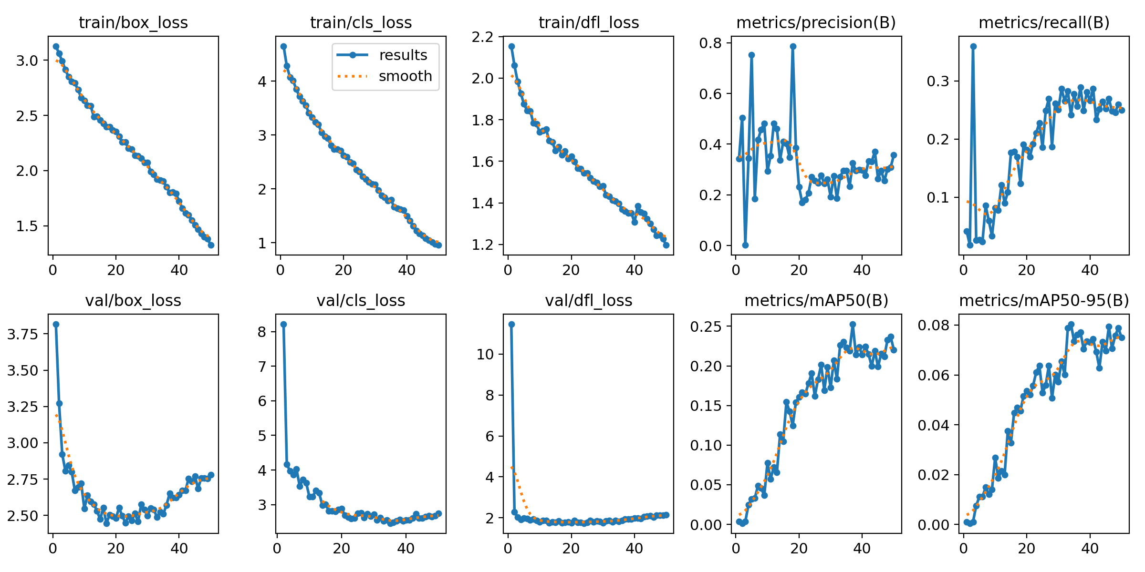
6.1 Results

Slide 12
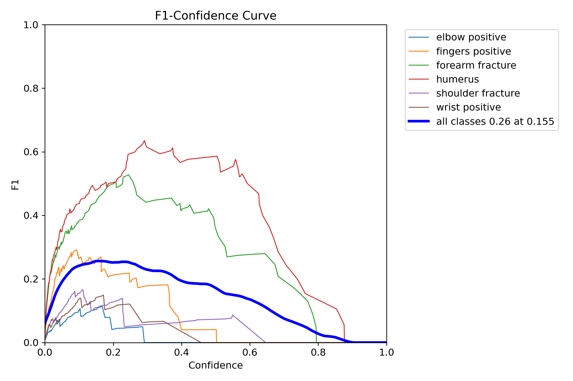
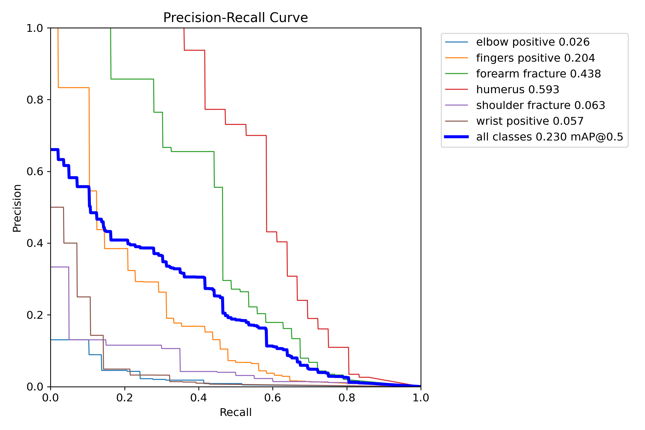
6.1 Results

Slide 13
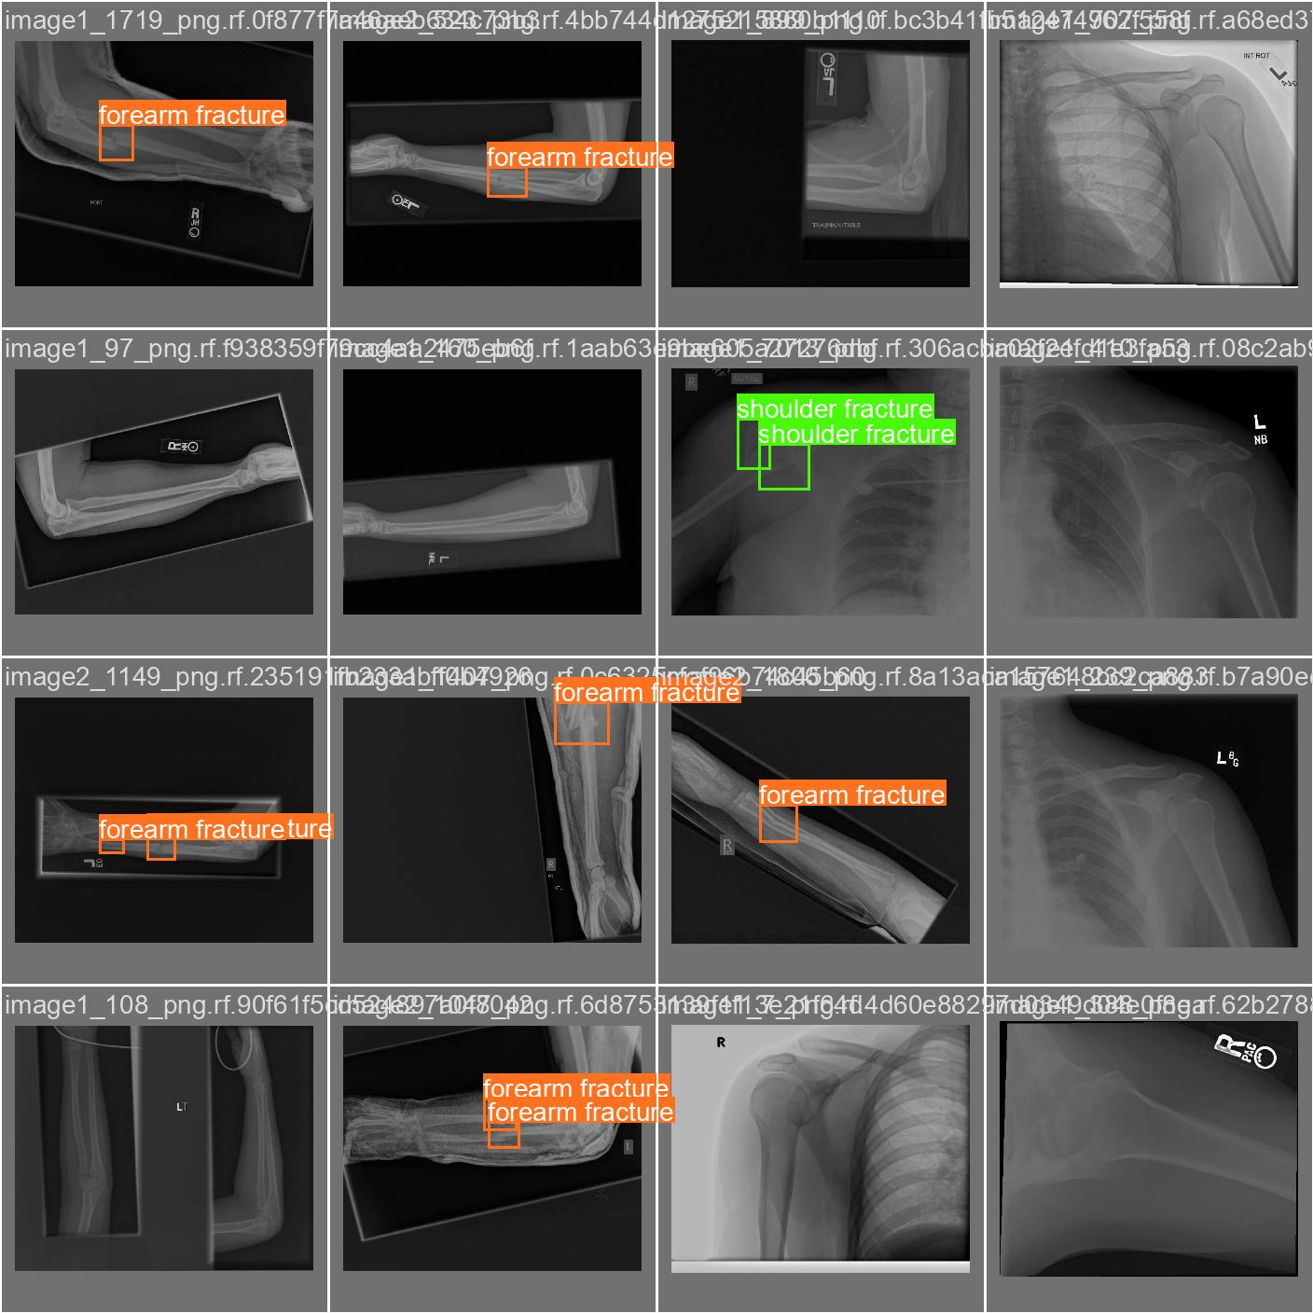
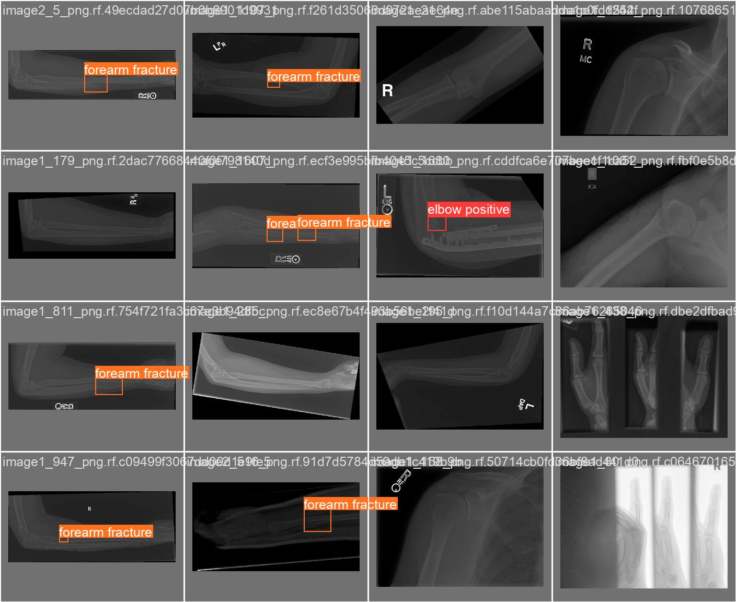
6.1 Results

Slide 14
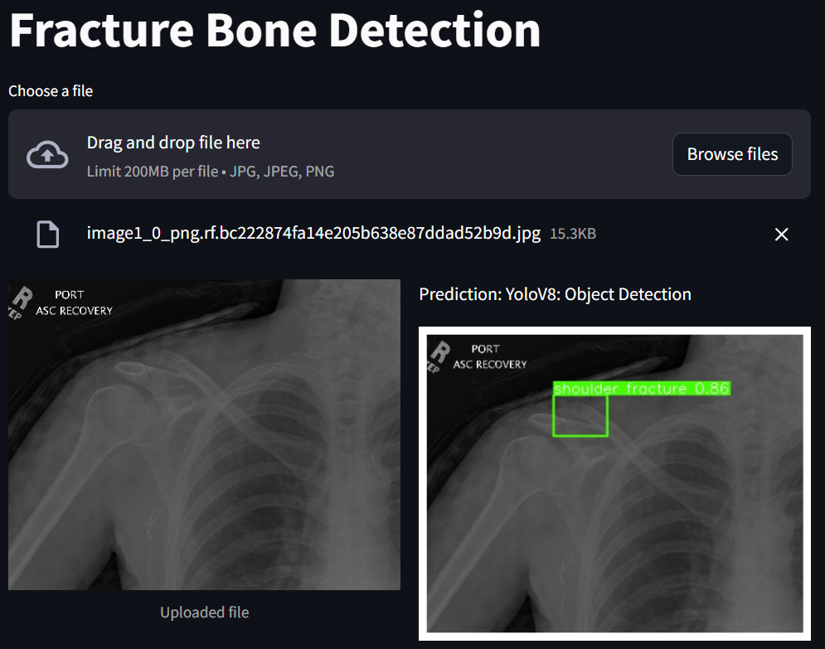
6.2 Results with Streamlit and FastAPI

Slide 15
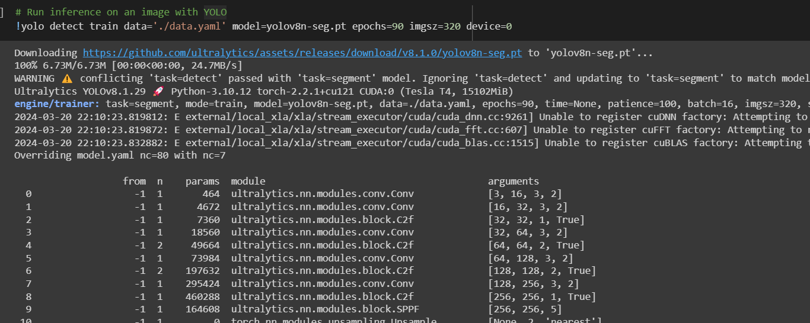
7. YOLO-V8 WITH INSTANCE SEGMENTATION
ultralytics
The YoloV8-SEG model is a pretrained model downloaded from the library “Ultralytics”.
The YoloV8 was finetuned to bone fracture instance segmentation.

Slide 16
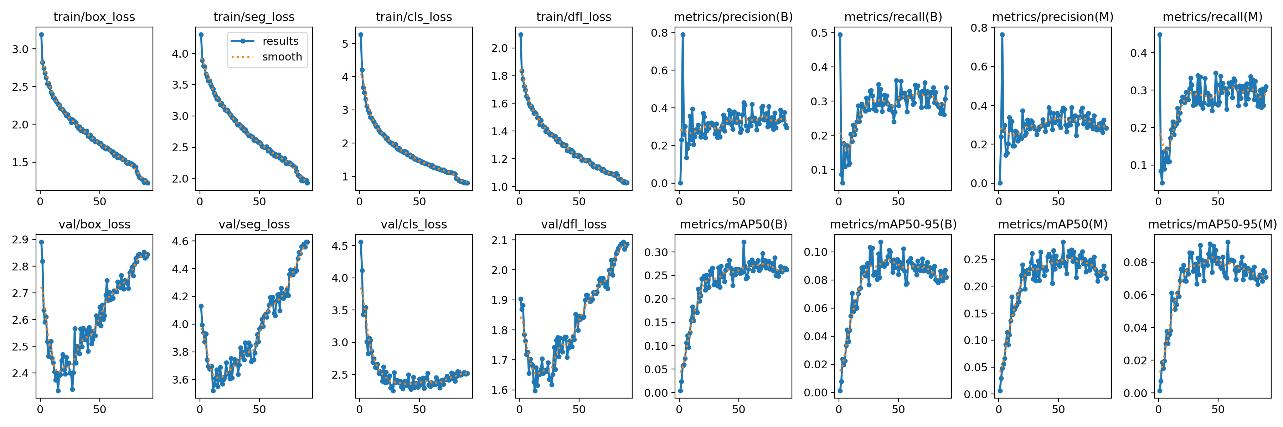
7.1 Results

Slide 17
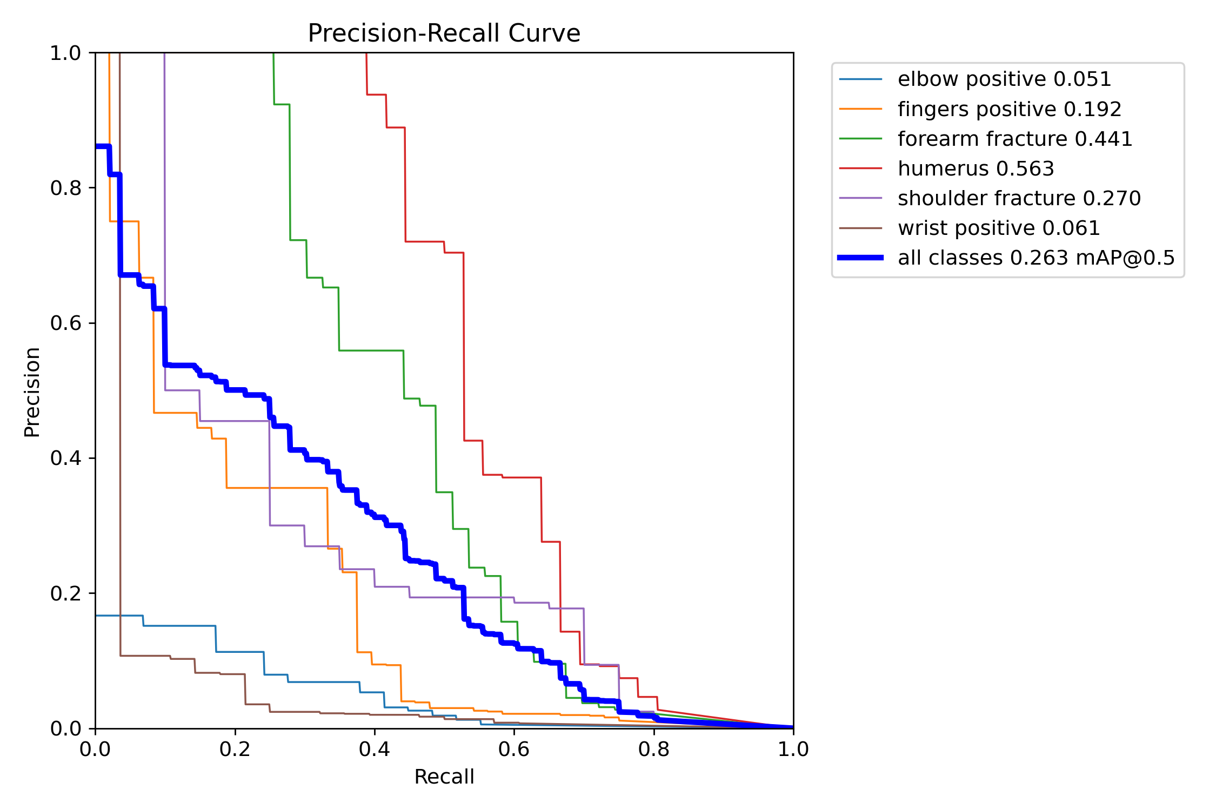
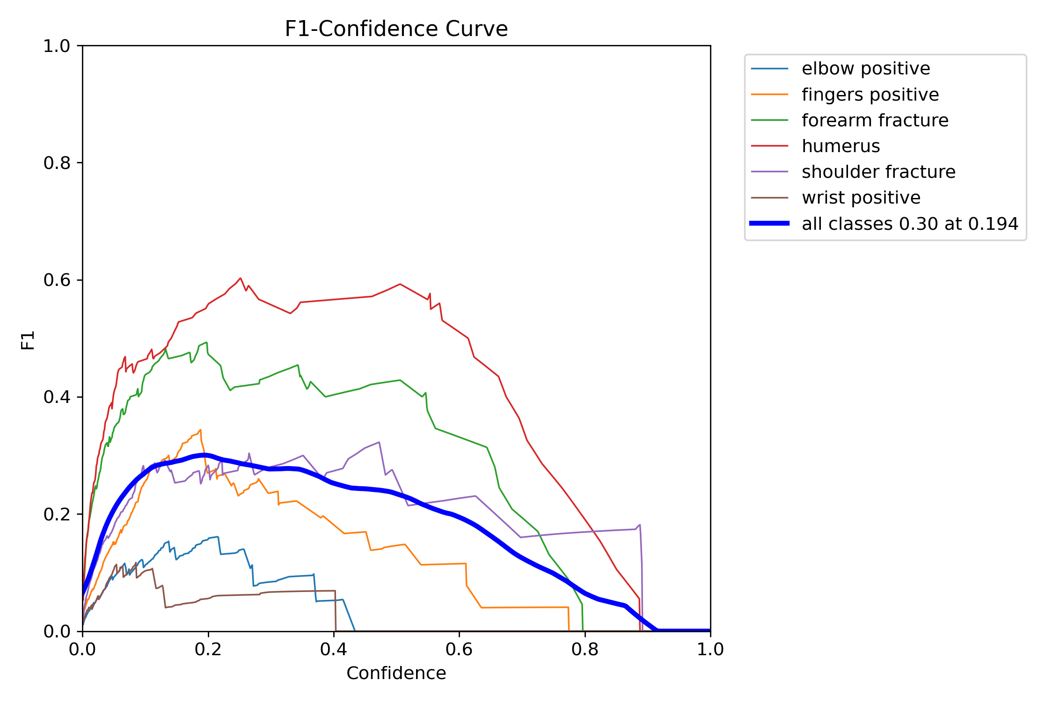
7.1 Results

Slide 18
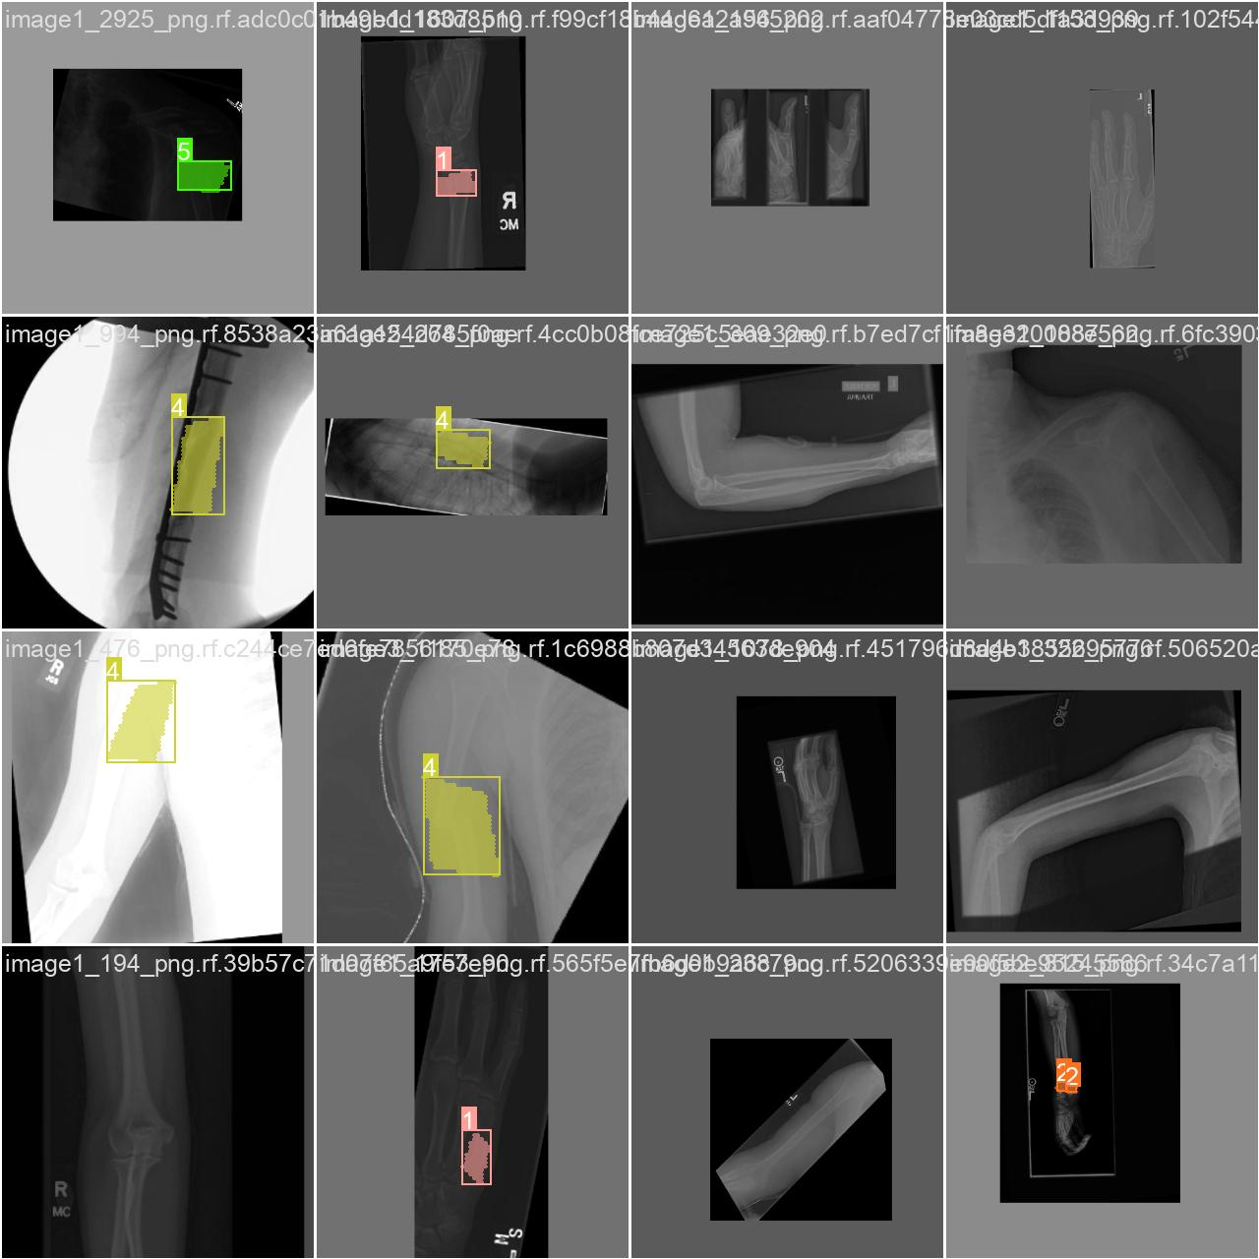
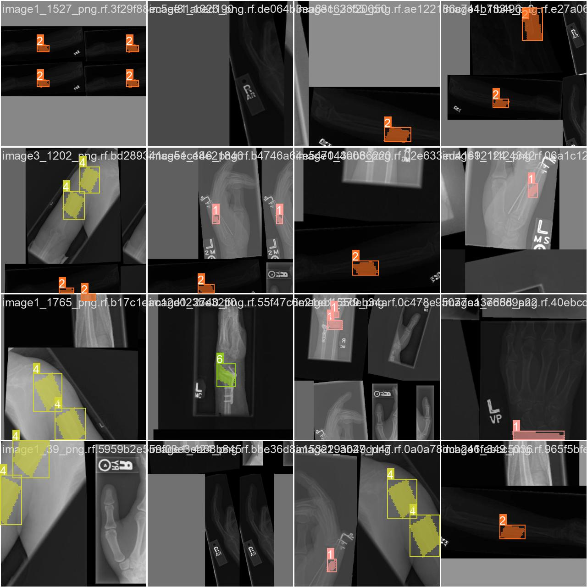
7.1 Results

Slide 19
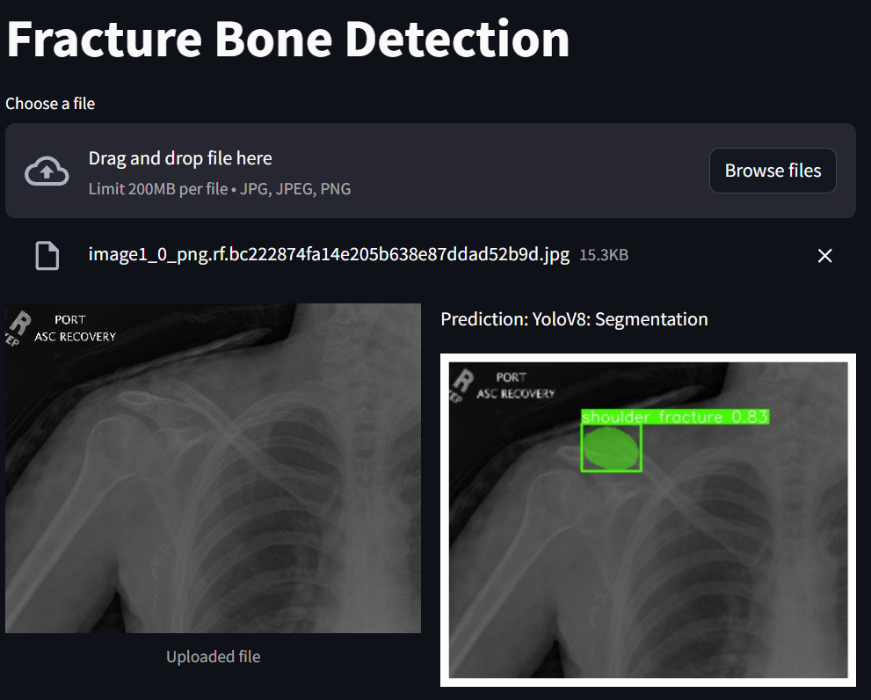
7.3 Results with Streamlit and FastAPI

Slide 20
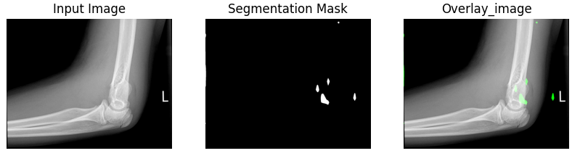
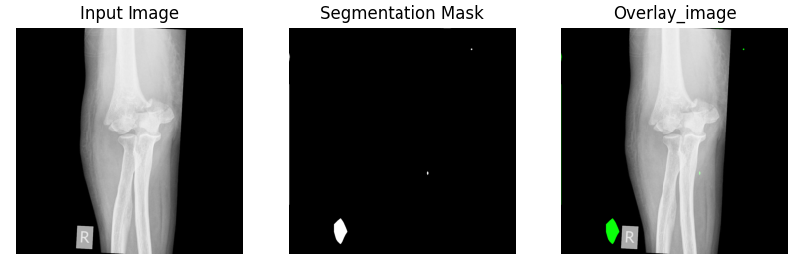
8. Conclusions
1. Resnet strugle to make instance segmentation as is shown bellow:

Slide 21
8. Conclusions
2. Using Resnet with FastAPI has a lower response time in the server.
3. Using Yolo model has a relative higher response time in the server using streamlit and FastAPI.
4. Segmentation using YOLO could be improve by fine-tuning the model for more epochs or with more data for the training.
5. The deployment of the models on the server was successfully completed.

